Slide 1
Sales Analysis of France
By : Harsh Prajapati

Slide 2
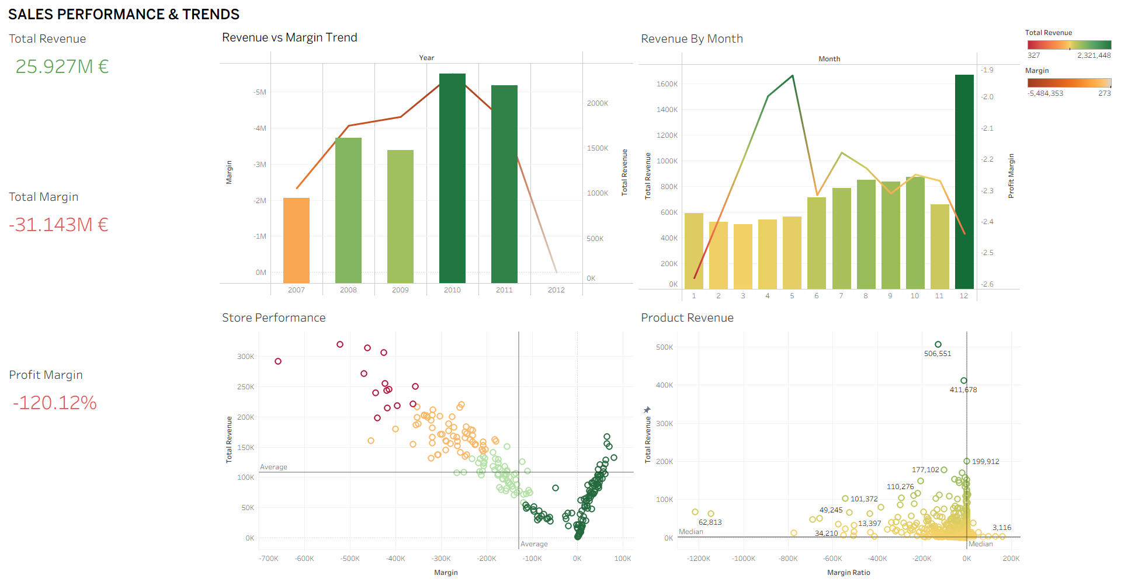
Dashboard 1

Slide 3
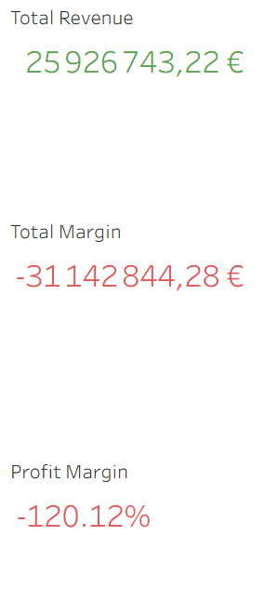
Over the analysed period, Stores generated approximately €25.9 million in total revenue.
However, when we analyse total margin, we observe a cumulative loss of €31.1 million.
With a profit margin of –120%, Stores are losing €1.20 for every €1 earned.

Slide 4
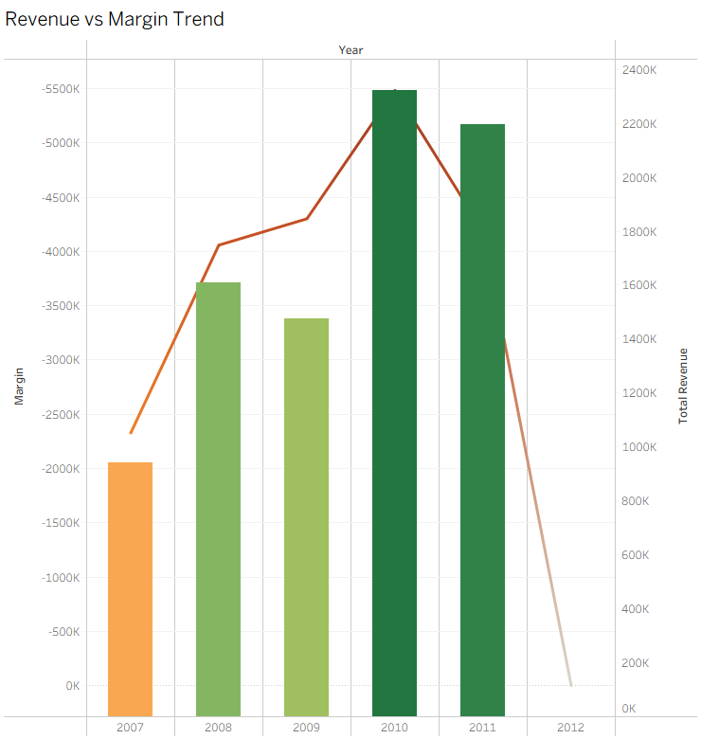
Revenue increased from 2007 to 2010 and then became stable.
However, losses also increased during high revenue years.
This shows that higher sales did not lead to profit.

Slide 5
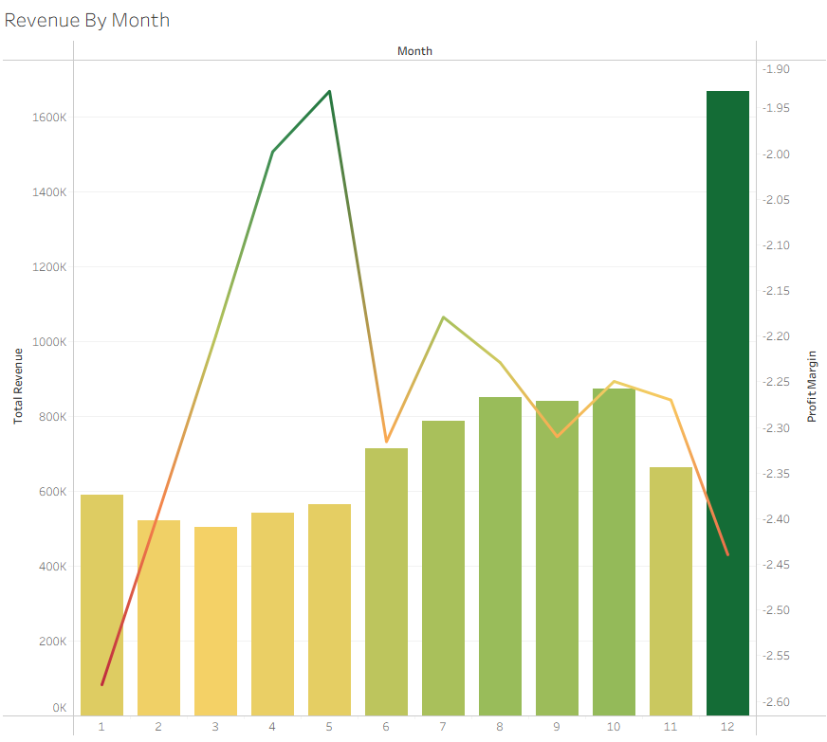
Revenue changes across months, with clear peak periods.
Month 12 shows the highest revenue of the year.
However, profit margin remains negative even during peak sales.

Slide 6
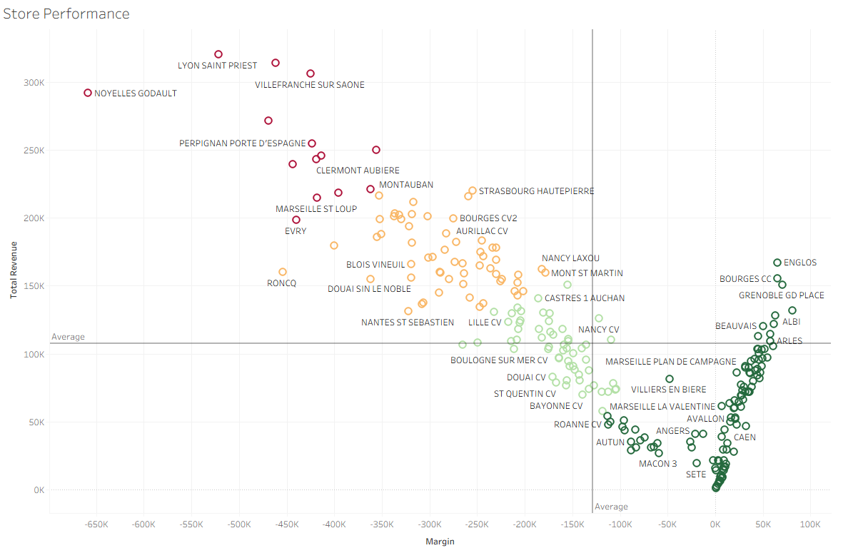
Store performance varies significantly across locations.
Red and orange stores show high losses despite strong revenue.
Green stores perform better, with positive or lower losses.

Slide 7
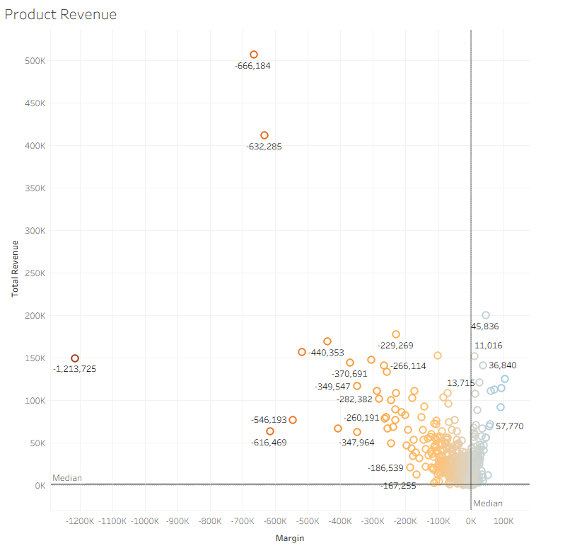
Products with high negative margin should be reviewed immediately.
Prices may need to increase, or production and supply costs must be reduced.
If they cannot become profitable, they should be replaced or discontinued.

Slide 8
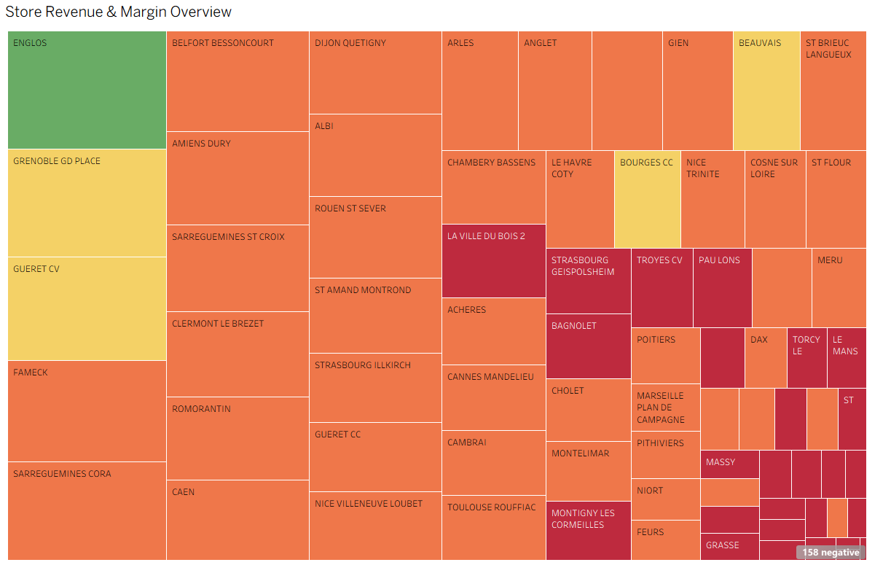
A small number of stores generate most of the revenue.
However, many stores operate with negative margins (shown in red and orange).
This shows that the loss problem is spread across multiple locations.

Slide 9
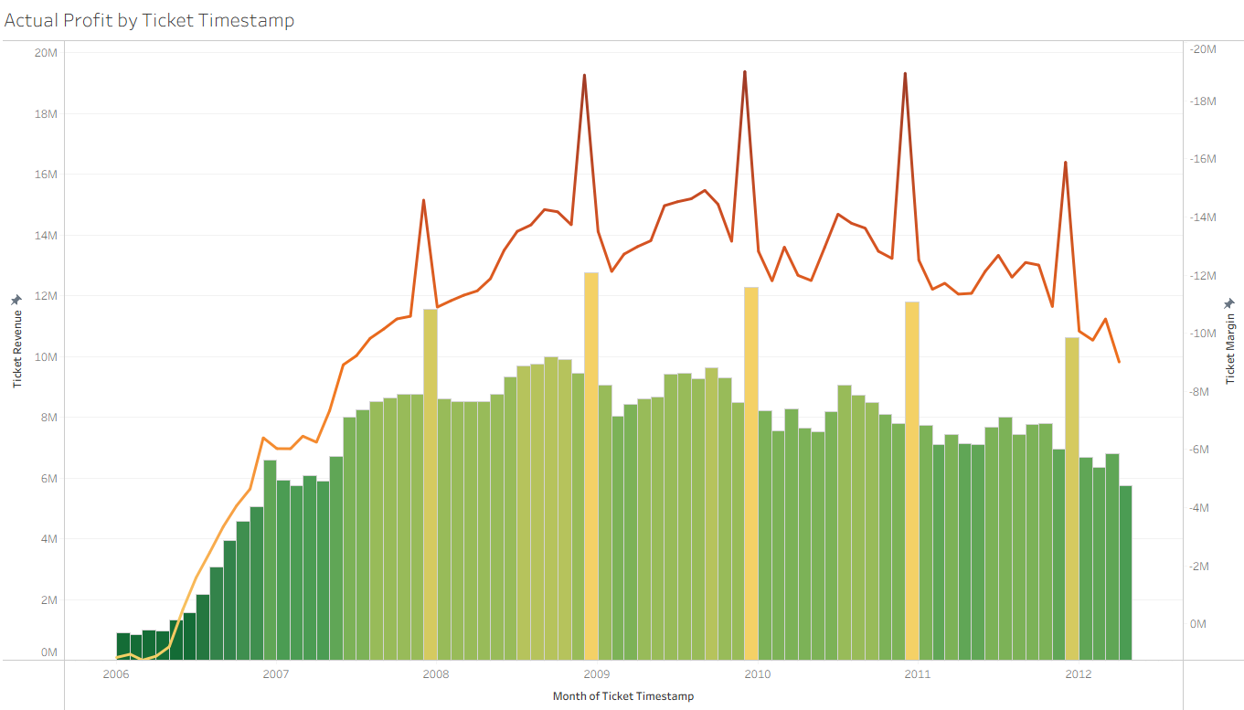
Actual Profit by Ticket Timestamps
Revenue increased strongly from 2006 to 2008 and then stabilised.
Profit (margin) remains negative and shows large fluctuations over time.
The company is selling more but still losing money.

Slide 10
Strategic Conclusion & Next Steps
Strategic Summary
Revenue vs. Margin: While the €25.9M revenue demonstrates strong market demand, the €31.1M margin deficit highlights a critical need for operational restructuring.
The Growth Paradox: Higher sales volume has historically led to deeper losses; we must shift focus from "selling more" to "selling profitably."
Immediate Action Plan
Optimize the Network: Prioritize and replicate the "Green Store" model (profitable locations) across the entire French market.
Rationalize the Portfolio: Review and potentially discontinue high-revenue products that carry significant negative margins.
Pricing & Costs: Implement immediate reviews of production costs and supply chain efficiency to protect the bottom line.
By aligning sales volume with margin efficiency, the French market can transition from a loss-leader to a profitable cornerstone of the company.

